Slide 1
Restoration
In the ravished country of Haiti where many humanitarian efforts fall short, the answer may lie just beneath the surface of the water

Slide 2
Table of Contents
Introduction to Restoration……………………………Page 3
Importance of Coral Reefs………………………………Page 4-5
Ecosystem Services Provided………………………….Page 6-9
Reefs in the Caribbean……………………………………Page 10-11
Introduction to Reef Conservation…………………Page 12-17
Action Plan, Summer 2017……………………………..Page 18
Responsible Ecotourism Activities…………………Page 19
Long Term Outline………………………………………..Page 20
How You Can Help…………………………………………Page 21

Slide 3
3 Means of Restoration in Haiti
Restore Haiti’s coral reefs, marine ecosystems and a healthy fish population
Educate and empower Haitians to participate in active restoration of their economy
Restore eco-driven tourism to this once highly sought after destination
Why are coral reef and marine ecosystems so important to Haiti?

Slide 4
Coral Reef Facts
Coral reefs cover less than 1% of the Earth’s surface, but they are home to 25% of all marine fish species.
Coral reefs are one of the oldest ecosystems on Earth
Corals have shown remarkable resilience through major climate events and sea level changes

Slide 5
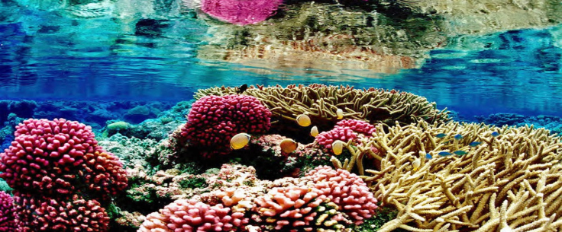
Precious Resource
Annually coral reefs provide a financial benefit estimated at $352,000/ha from recreation, fish
habitat and coastal protection from storms
The value of coral reefs globally is $9.9 trillion US
(Costanza et al. 2014)

Slide 6
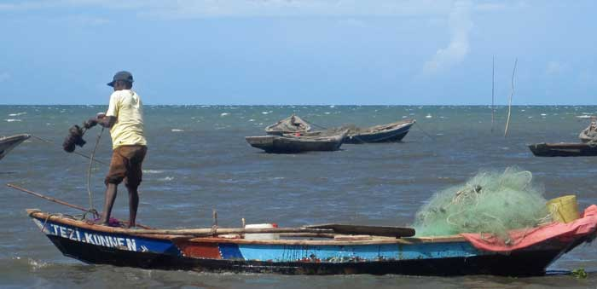
Food and Fishing
About 1 billion people, mostly in developing nations, rely on fish as staple source of protein
“Fish as Food,” Marine Stewardship Council

Slide 7
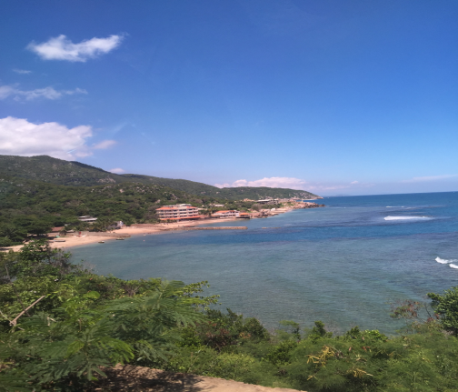
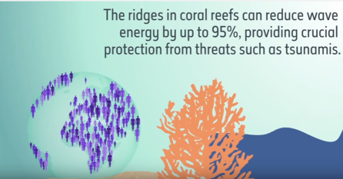
Coastal Protection
Coral Reefs act as a
Buffer against large
waves, hurricanes
and other storms
Source: 2017 National Oceanic and Atmospheric Administration , U.S. Department of Commerce

Slide 8
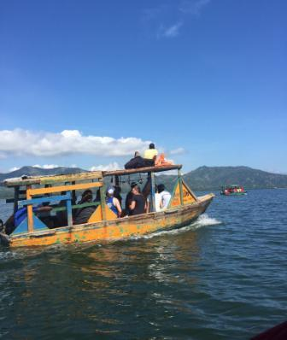
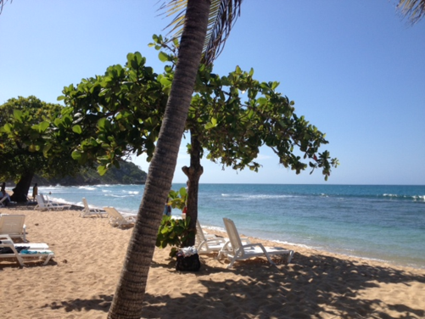
Tourism/Recreation
Coral reefs in the Caribbean
generate about $2.1 billion in
revenue each year
Source: 2014 (DEMA)
Diving Equipment and Marketing Association

Slide 9
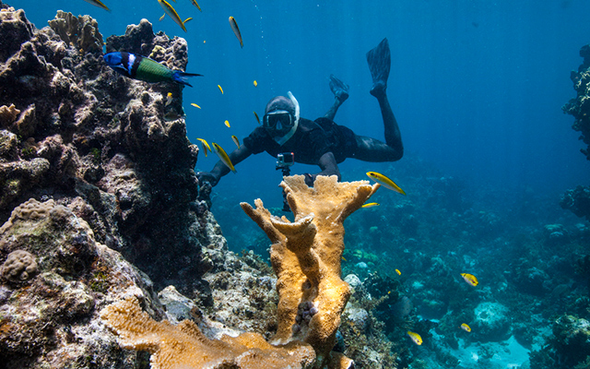
Medicinal & Research Value
Coral reefs are sometimes considered the medicine cabinets of the 21st century. Coral reef plants and animals are important sources of new medicines being developed to treat cancer, arthritis, human bacterial infections, Alzheimer's disease, heart disease and viruses oceanservice.noaa.gov

Slide 10
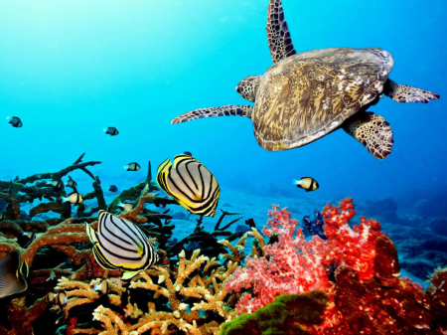
Importance to Caribbean Nations
12% of employment in the Caribbean is attributable to marine related activities
About 13% of Caribbean countries’ GDP is attained from their marine ecosystems.
*Haiti does not currently enjoy these benefits

Slide 11
Destruction of Reefs in the Caribbean
Coral cover has declined since the 1970’s far above 50% in many parts while the more fortunate areas have experienced only about 15% decline
Estimated loss of between US$350 million and US$870 million per year by 2050 with continued decline
Every major commercially important marine species in the region is reported as over-exploited or fully developed as of 2005

Slide 12
What can be done to keep the reefs and all of their ecosystem services in Haiti?

Slide 13
Coral Reef Conservation
Marine Protected Area (Fish Sanctuary)
Coral Nursery
Healthy reef practices
Ecotourism

Slide 14
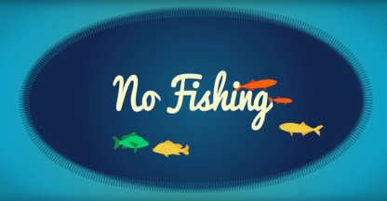
Here’s the basics of reef conservation:
Creating Marine Protection Areas (otherwise known as Fish Sanctuaries) is the start to restoring the fish populations
How do they work?

Slide 15
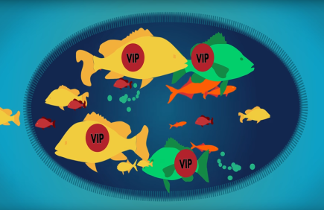
Creating fish sanctuaries
works in 2 ways:
Spillover effect- Fish populations multiply faster within the sanctuary and spill over to the fishing zones
Protecting the larger, mature fish-The larger fish create their territory within the sanctuary and remain protected…Why is this important?
Consider this: A 1 pound snapper can
produce 36,000 eggs but a 6 pound
snapper can produce over 3 million eggs

Slide 16
Live off of the interest and therefore protect the deposit
The bigger you grow the deposit (fish populations), the more interest you can receive (food)
The local Haitians are living off of the interest and deposit and driving the fish populations towards nonexistence
If they can protect the deposit (fish populations in the sanctuaries) , the more interest they can receive (food from the fish outside of the protected zones)

Slide 17
This model has had proven success in many cases in the Caribbean

Slide 18
My purpose for going to Haiti in Summer 2017
Build relationships with local fishermen and educate them on the issue they are facing
Team up with these dedicated native citizens along with our Amiga Island partners who have recently initiated reef conservation and combine efforts to carry out a sustainable conservation plan
Hire a team of Haitians to construct 5-pronged rebar structures (referred to as “coral spiders”) used as anchors for corals to grow on and place them among the damaged reefs. Goal is to place at least 75 structures throughout the 10 week period
Deliver resources to the Haitian based project in order to support indigenous leadership to reinforce their sense of ownership and responsibility which will give the project the highest likelihood for long term success
Facilitate missionary groups who are interested in the conservation effort by participating in exciting new citizen science projects

Slide 19
Featured Citizen Science Projects
Coral Reef Exploration Excursions
Promote awareness visiting sick and healthy reefs
Support Haitian economy with, guides, boat use and fuel consumption
Initiate ecotourism efforts and promotion by experiencing beauty of the reefs up close
Snorkeling and Eventually Snuba and Scuba
Experiential fieldwork for interns
Fish and Coral ID
Assist in reef maintenance and upkeep
Help with coral nursery “gardening” and expansion
Note: Royal Caribbean currently offers tourism on the coast of Haiti but their methods are destructive and irresponsible to both the local community and the ecosystem

Slide 20
Long-term outline/plan of marine conservation in the Cap-Haitien area
Marine Protected Area (MPA)
Fishermen of the area hired to protect the MPA
Increased reef health
Ability to draw in ecotourism
Creation of lodge and scuba center
Local employment opportunities
Improvement of local fishing industry*
=
More sustainable
ecosystem, resources,
and economy!

Slide 21
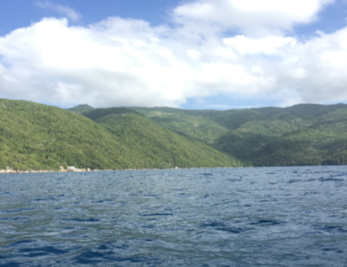
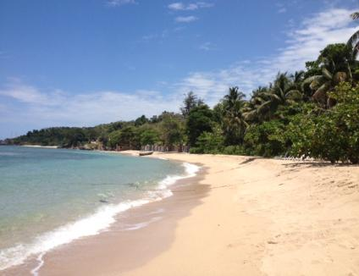
Help Haiti Keep Their Valuable Resources
Through good partnership and education, Haitians will benefit from healthy coral reefs almost immediately and for years to come
For questions about the project or to find out how to get involved, contact Ben Schweiger at bschweiger24@gmail.com or by phone at 412-926-3976

